Slide 1
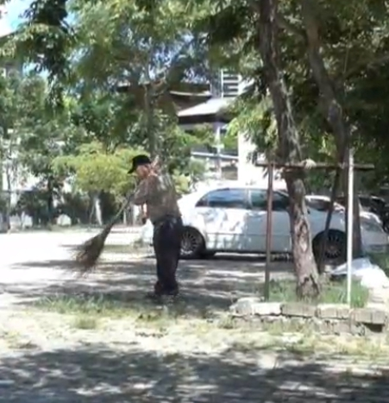
Tzu chi English Educational Practical Wisdom
Speaking
Being able to express your opinion
Listening
Active Listening with understanding
Creativity
Adding new thoughts to the discussion
Questions
Team Building
Asking poignant questions
Skills Fostered in this Class
Central points
It takes lots of experience to learn how to care for people;
Strive to be the moral heroes to the people that you mentor;
Pay attention to what we do and how we do it
The single most important thing that kids need to learn is character
Create a word bank for discussion
Wisdom comes from experience;
Incentives sometimes clash
Know how to improvise
Wisdom is to serve not to manipulate
When and how to make the exception to every rule
You don’t need to be brilliant to be wise
Without wisdom brilliance isn’t enough
Nurture moral skill and moral will
Christopher Bauman – www.chrisbauman.com.au

Slide 2
1. Make a job description for a janitor? (what human interactions could you include?)
____________________________________________________________________________________________?
Advanced Question Words
Made not born
2. Practical wisdom is the combination of moral will and moral skill ___________________________________________________________________________________________ ?
Cutting edge
3. A jazz musician – inventing music appropriate for the situation and the people at hand ___________________________________________________________________________________________ ?
Kindness; care & empathy
4. Time to improvise and gain experience, permission to gain experience, willingness to learn from failures, be mentored by wise teachers ___________________________________________________________________________________________ ?
Ambiguous and ill- defined
Time is racing
5. How do you measure empathy? ___________________________________________________________________________________________ ?
Think of an ordinary hero
Swimming against the current
Moral skill is chipped away by an over reliance on rules
6. Rules are needed, but too many rules assure mediocrity. ___________________________________________________________________________________________ ?
People are inspired by moral heroes
7. Ask not just is it profitable, but is it right? ___________________________________________________________________________________________ ?
Daily failure
8. Think of something within the scope of your ability that is the right thing to do ___________________________________________________________________________________________ ?
Talent is rampant
Celebrate moral exemplars (heroes); know the people around you; any work that involves interaction with other people is moral work…. Add to this list -
Christopher Bauman – www.chrisbauman.com.au

